Slide 1
Data ANALYTICS INTERNSHIP the shaadi times
Impact of Air Pollution on our Lives

Slide 2
LOCKDOWN AND IT’S EFFECTS
On March 15 2020, the Indian government placed its population of more than 1.3 billion citizens under lockdown in an effort to reduce the spread of the COVID-19 disease. All non-essential shops, markets and places of worship were closed with only essential services including water, electricity and health services remaining active.
Citizens started to experience better air quality so much so that the scenic Dhauladhar Peaks of Himachal Pradesh became visible from neighbouring states. On normal days, these peaks lie hidden behind he film of smog.

Slide 3
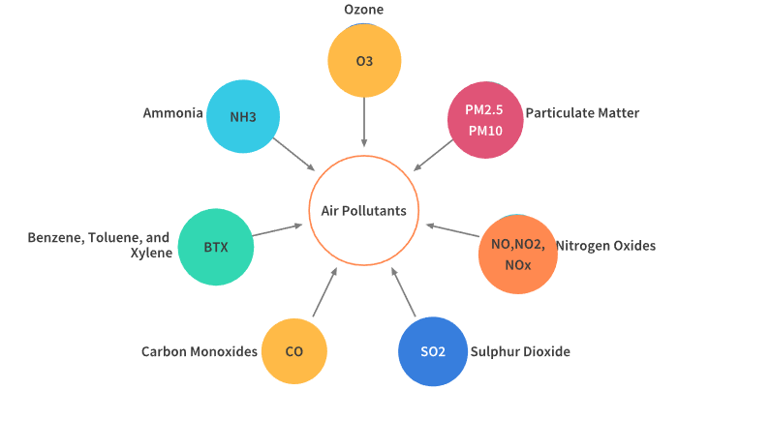
LETS HAVE A LOOK AT SOME OF THE POLLUTANTS RESPONSIBLE FOR AIR POLLUTION IN INDIA
This are some of the pollutants responsible for air pollution due to the gases released by industries and vehicles.The dataset taken from kaggle (www.kaggle.com/datasets) has this gases given day by day for different cities with their proportions recorded daily.

Slide 4
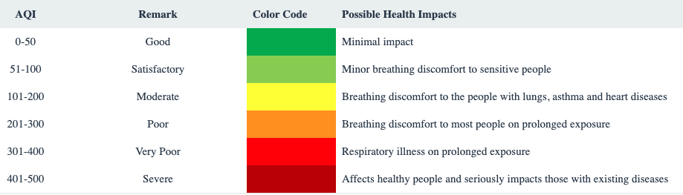
HOW TO DETERMINE AIR QUALITY INDEX (AQI)
An air quality index (AQI) is used by government agencies[1] to communicate to the public how polluted the air currently is or how polluted it is forecast to become.There are six AQI categories, namely Good, Satisfactory, Moderately polluted, Poor, Very Poor, and Severe. The proposed AQI will consider eight pollutants (PM10, PM2.5, NO2, SO2, CO, O3, NH3, and Pb) for which short-term (up to 24-hourly averaging period) National Ambient Air Quality Standards are prescribed

Slide 5
How aqi has an impact on air pollution?
In the upcoming slides we would discuss the distribution of various gases in air in various cities across the years.
This slides will depict the charts which help us to know which cities are the most populated by certain gases.
Lets have a look at some of the cities vs gases proportions below

Slide 6
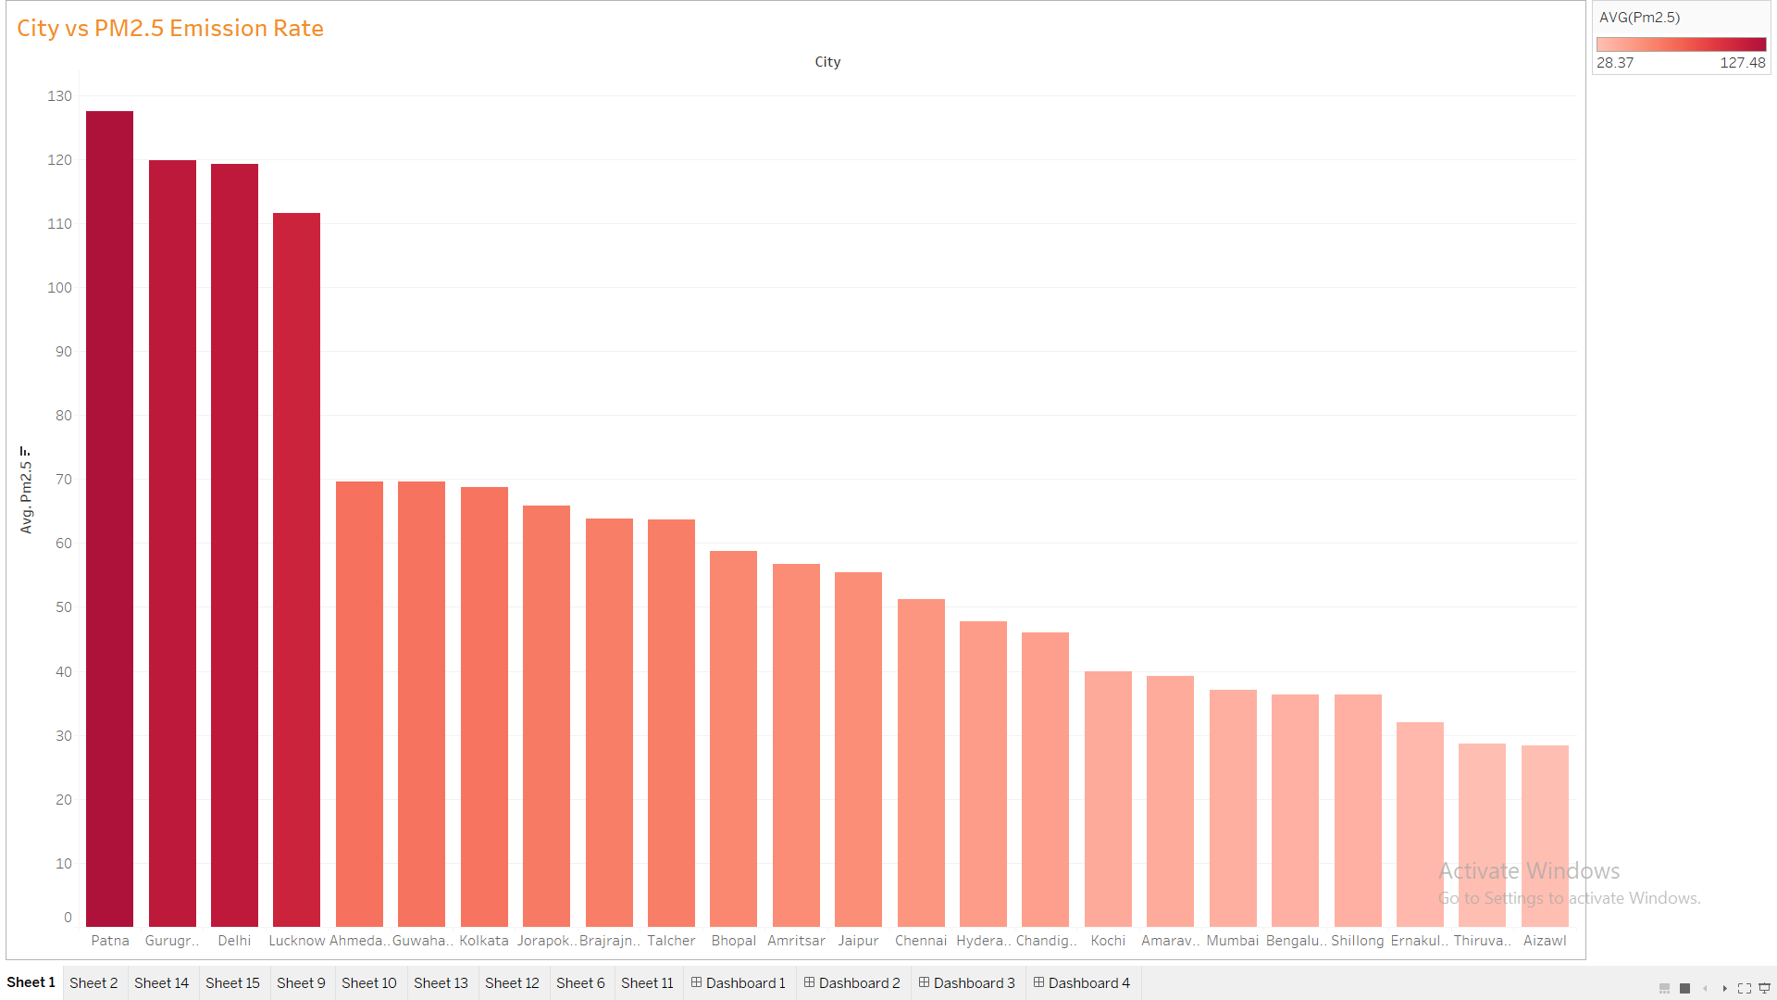
Cities vs pm2.5 emission rate

Slide 7
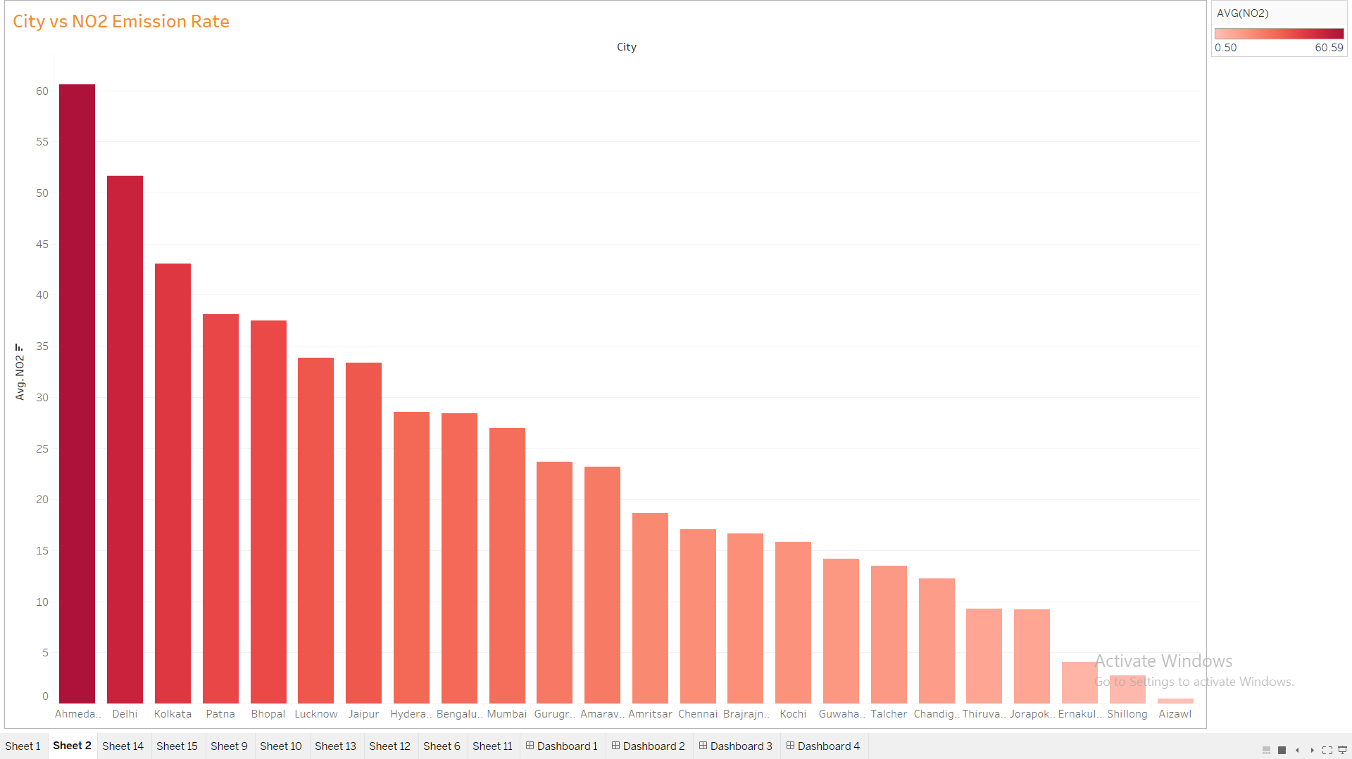
Cities vs pm2.5 emission rate

Slide 8
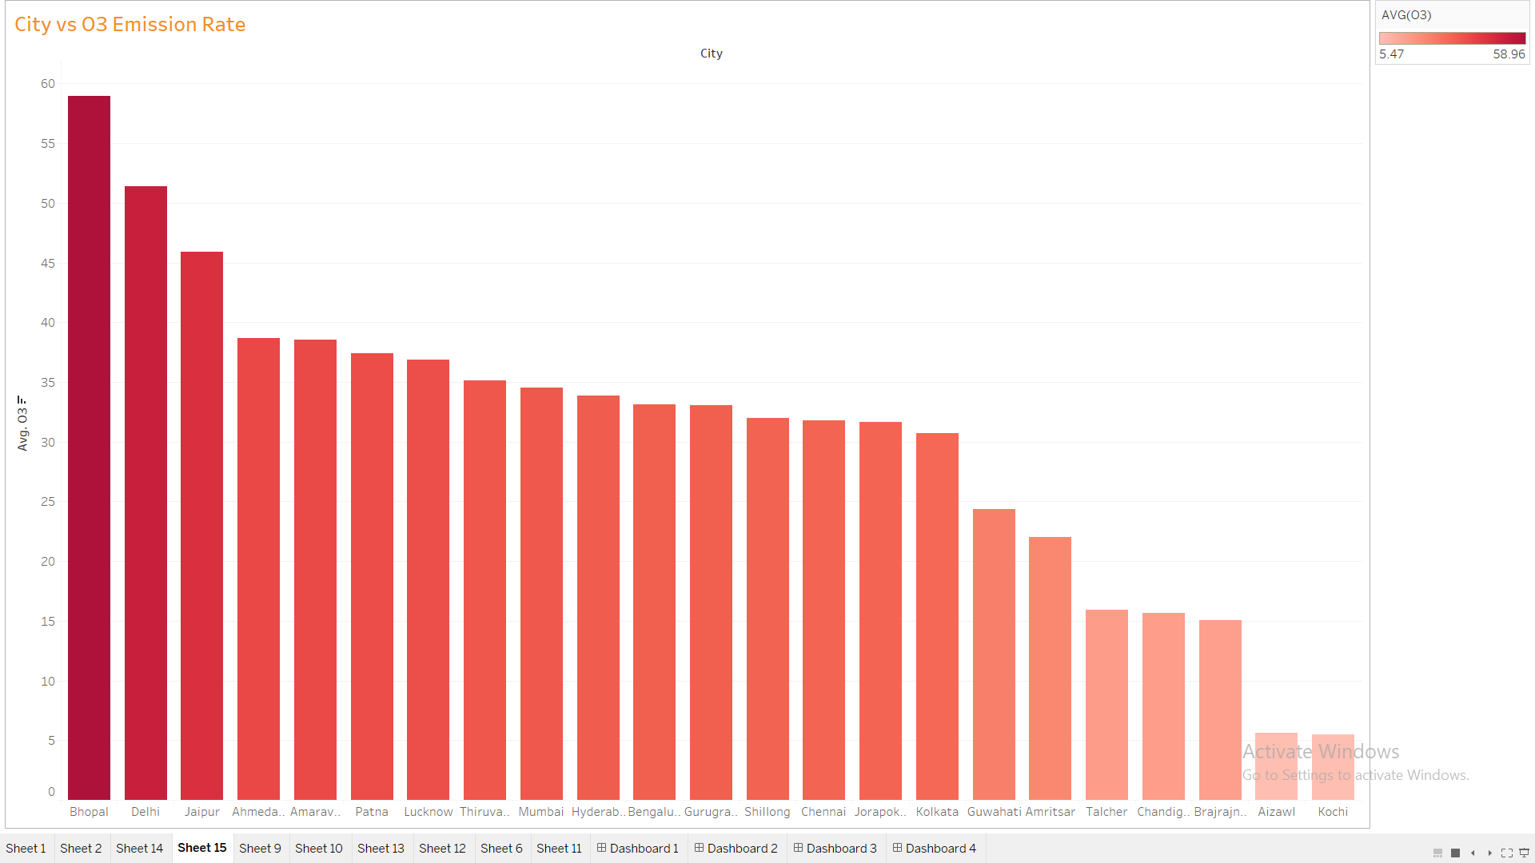
Cities vs pm2.5 emission rate

Slide 9
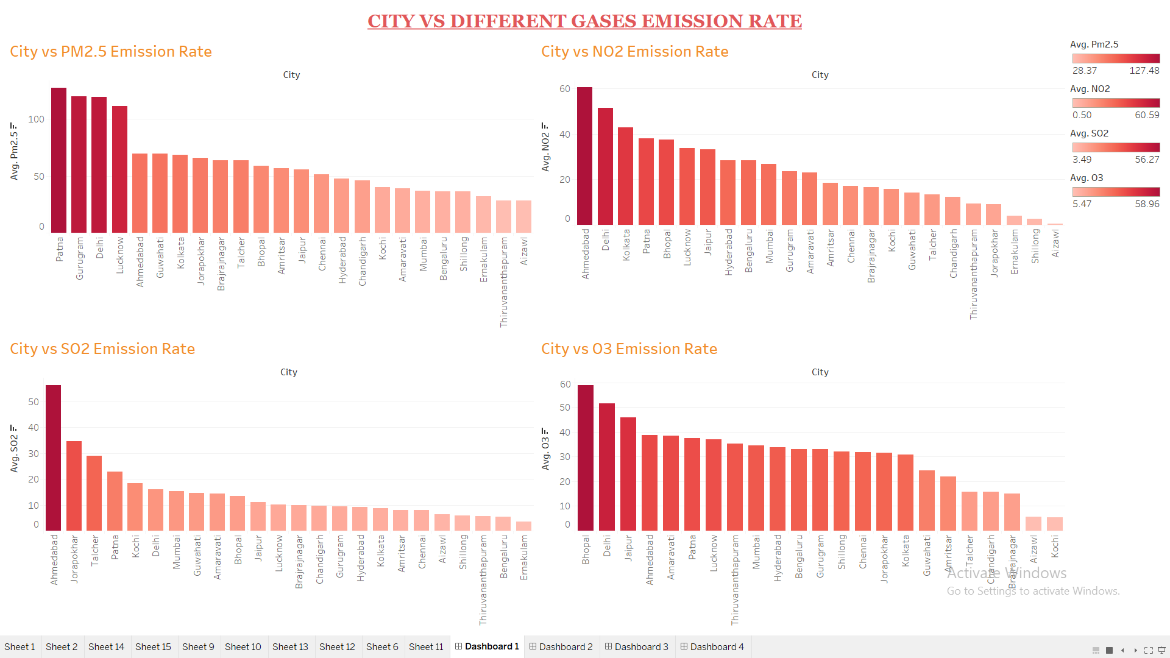

Slide 10
Conclusion from the cities vs gases graphs
Thus from the above graphs we conclude that some of the cities with the highest proportion of gases and highestr proportion of pollution are Mumbai , delhi, Ahmednagar, Bhopal, patna And kolkatta
Thus we would analyse the impact of pollution due to lockdown on this particular cities with usually high pollution

Slide 11
AQI INDEX AND CLASSIFICATION OF CITIES
THE AIR QUALITY INDEX WHICH IS MENTIONED ABOVE IS DIVIDED INTO FIVE CATEGORIES NAMELY :
1)SEVERE 2)VERY POOR 3)POOR 4)MODERATE 5)GOOD 6)SATISFACTORY
NOW WE WILL DIVE DEEPER INTO THE AQI OF DIFFERENT CITIES BEFORE LOCKDOWN AND AFTER LOCKDOWN

Slide 12
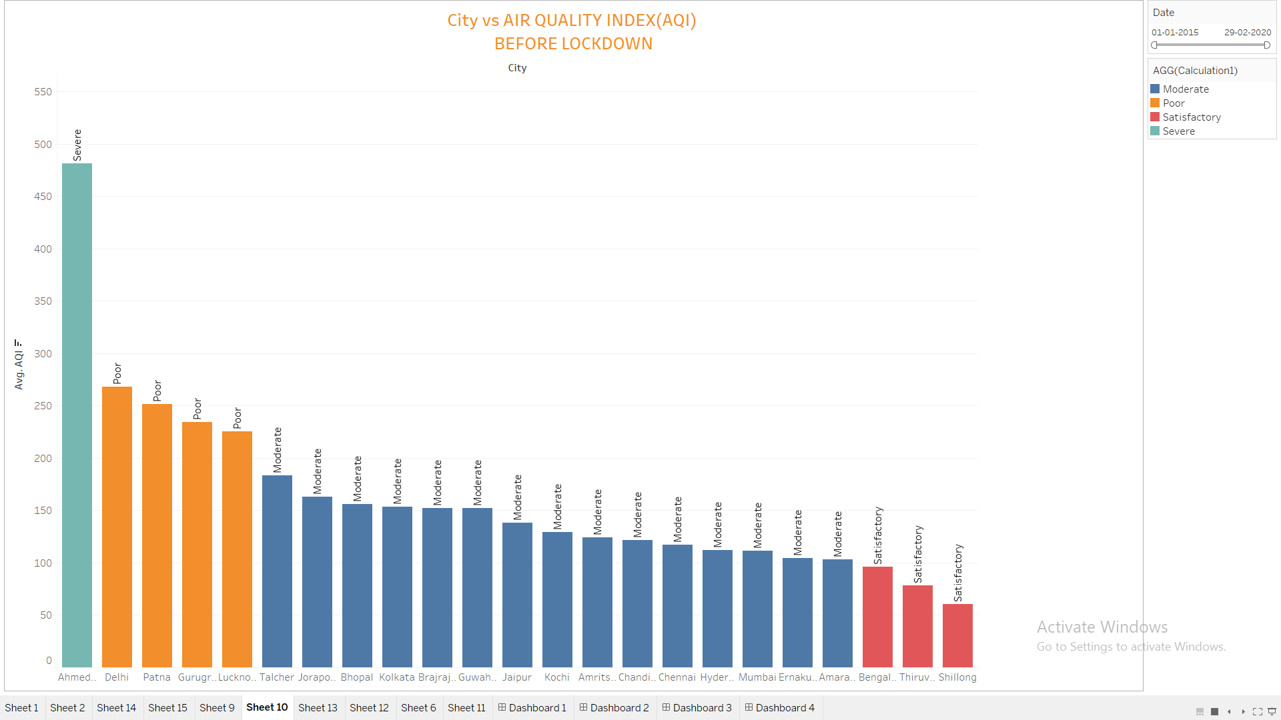
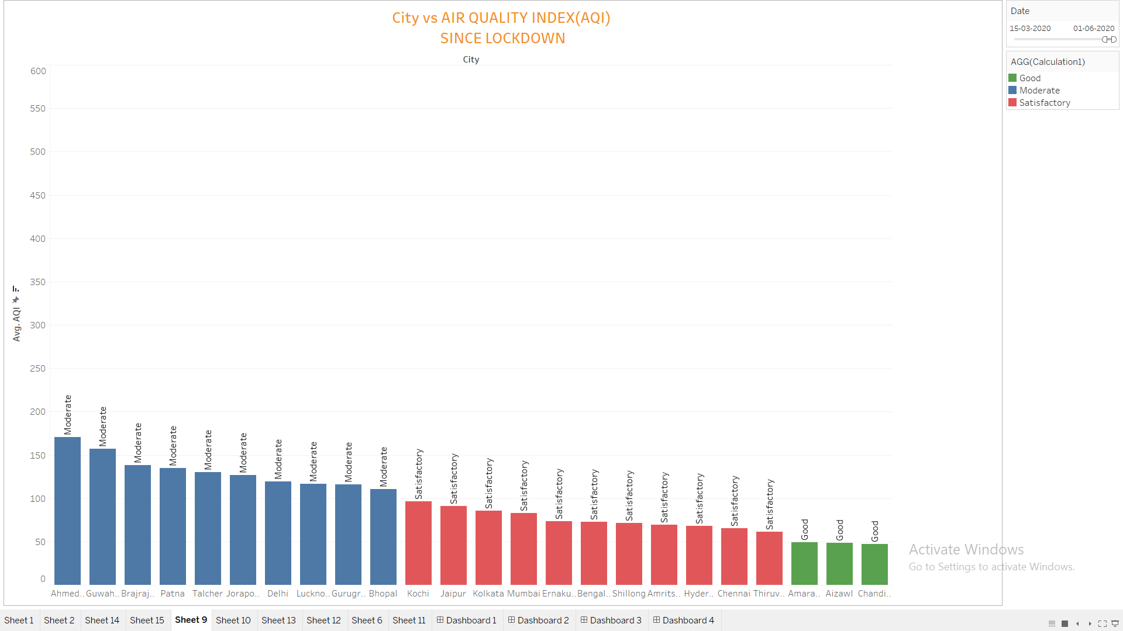
COMPARISON OF AQI BEFORE AND AFTER LOCKDOWN

Slide 13
Comparison of aqi before and after lockdown
FROM THE SLIDE ABOVE WE CONCLUDE THAT THERE IS DRASTIC CHANGE IN AIR QUALITY BEFORE AND AFTER LOCKDOWN.
Before lockdown period exists from 2015 to feb 2020 and the lockdown period exists since march 2020.
We can see the changes in some of the cities since lockdown
CITY | AQI BEFORE LOCKDOWN | AQI AFTER LOCKDOWN
DELHI | Poor | Moderate
LUCKNOW | Poor | Moderate
PATNA | Poor | Moderate
AHMEDABAD | Severe | Moderate
BHOPAL | Moderate | Satisfactory
CHANDIGARH | Moderate | Good

Slide 14
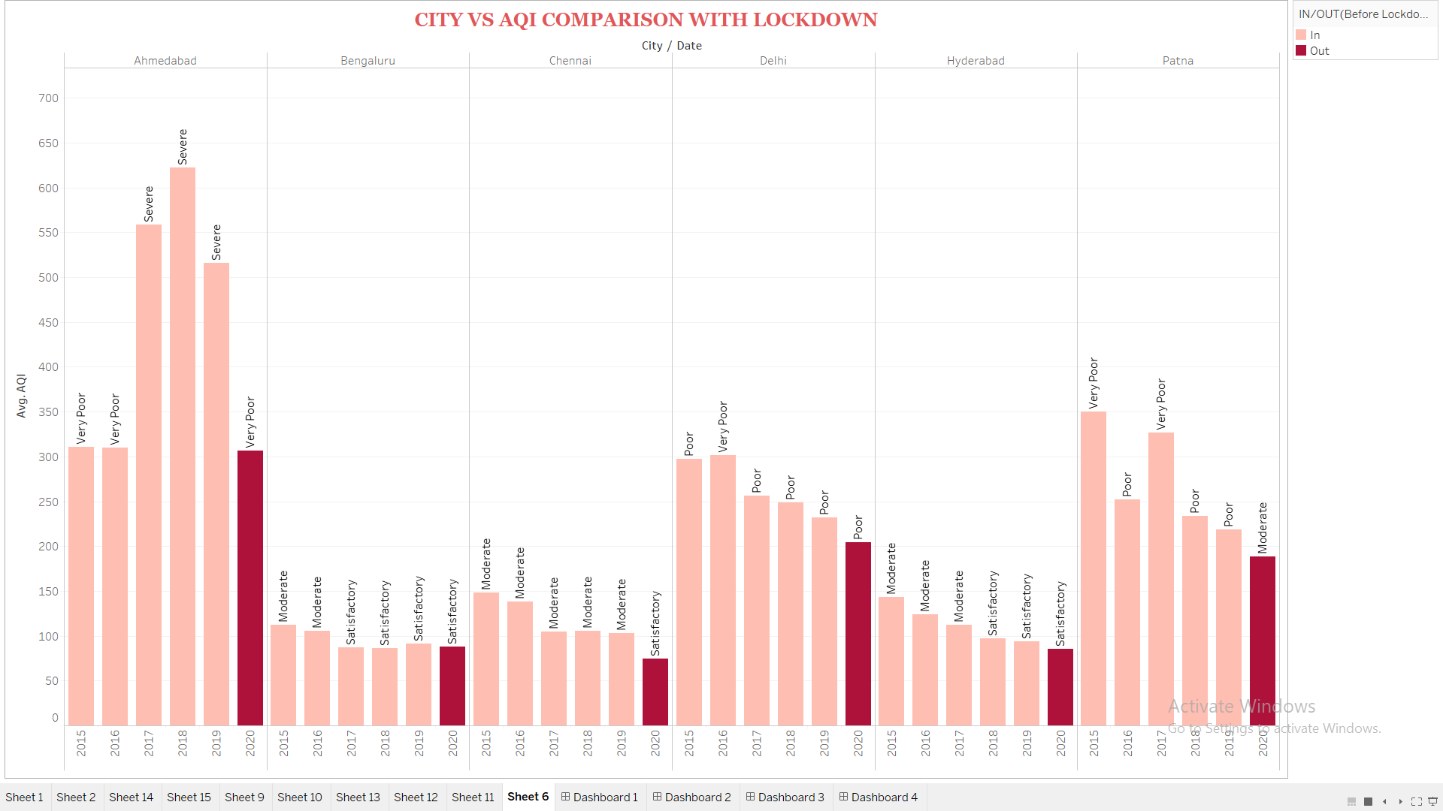

Slide 15
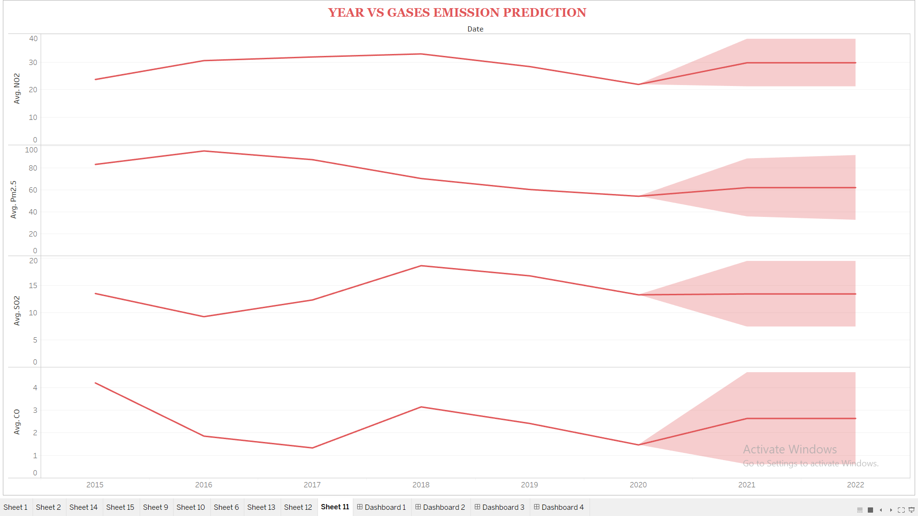
Gases emission prediction from 2020-2022

Slide 16
Conclusion from the concentration of gases in air from 2015-2020 and predictions for 2020-2022
While the concentration of major gases such as co2,so2,co,no2,o3 are decreasing in air,the pollution level of india has really improved from past 3 months.
While the concentration is expected to increase from end of 2020 to much higher levels

Slide 17
Air quality prediction for 2020-2022 in india
Now we will have a look at the most important factor
We will see the air quality index from 2015 to 2019 and post the lockdown phase we will forecast the air quality index from years 2020 to 2022.
The below graph depicts the forecast for the upcoming years

Slide 18
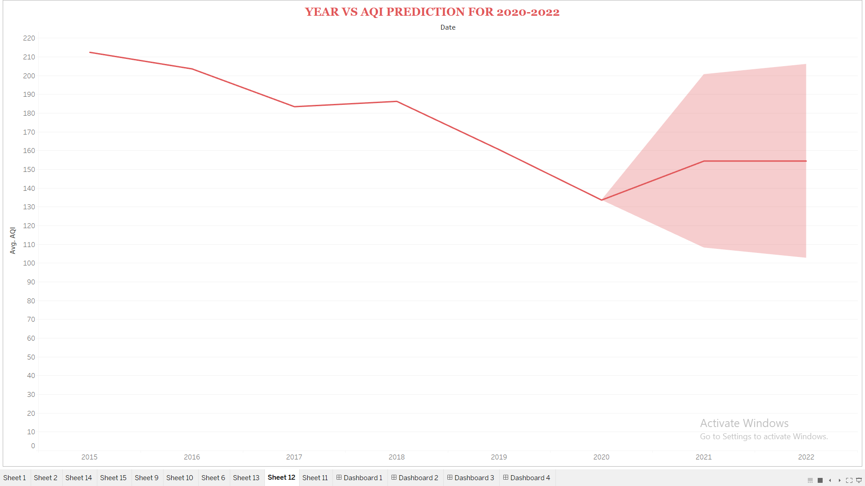

Slide 19
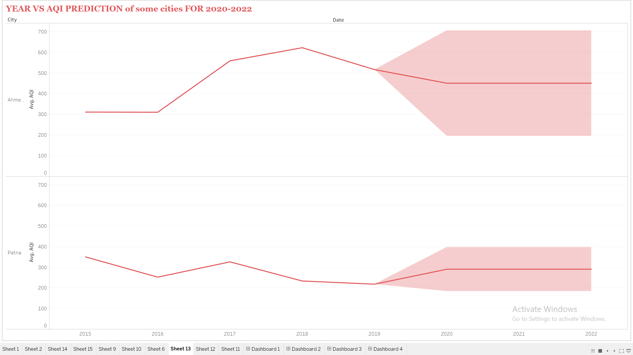
Aqi predictions for some citites having high pollution

Slide 20
conlusion
Thus from the above graph we depict that the air pollution level has gone significantly low in 2020 due to lockdown but in upcoming years from 2020 to 2022 the air pollution is expected to increase and thus the air quality will be degraded
The reason for this can be that people now will not get crowded and avoid using government vehicles and thus use private vehicles which might lead to high level of pollution .also industries reopening will have a huge toll on environment and will contribute to the rise of air pollution
Also upcoming 2 years rise in pollution might be more than the past 3 years as people will avoid getting in contact with each other and resulting in use of local trains, buses and other government vehicles.

Slide 21
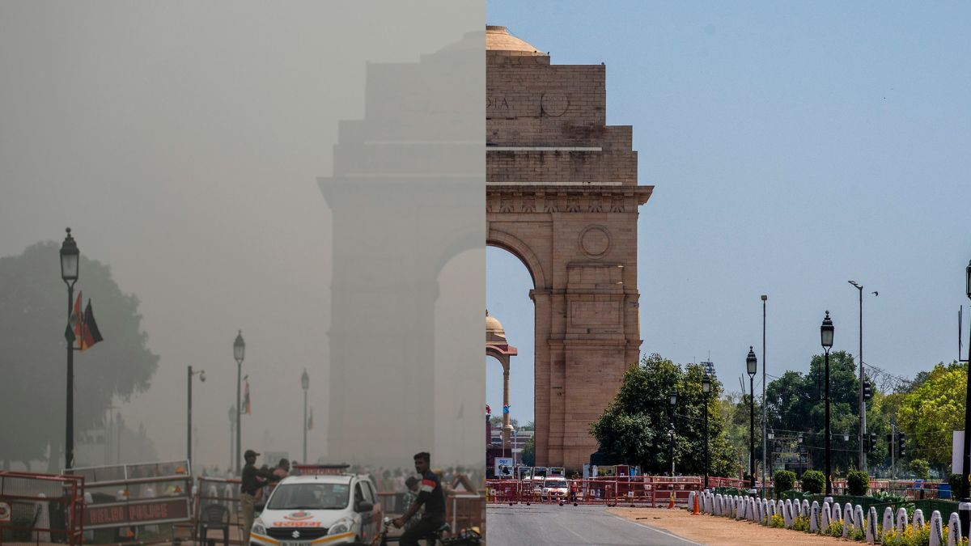
Final conclusion
This image clearly shows the effects of pollution before and after lockdown.
After lockdown the pollution level are so low that one can even see Himalayas clearly which were once hidden behind the polluted air from india.
But as the forecast suggests the aqi is expected to be worse by 2022 again.to keep air pollution under control is an individual duty.
Also there were some suggestions put forth by environmentalists that lockdown should be imposed for 1 week every year just for the betterment of air quality . individually we should look forward to take care of our country

